Slide 1
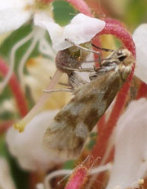
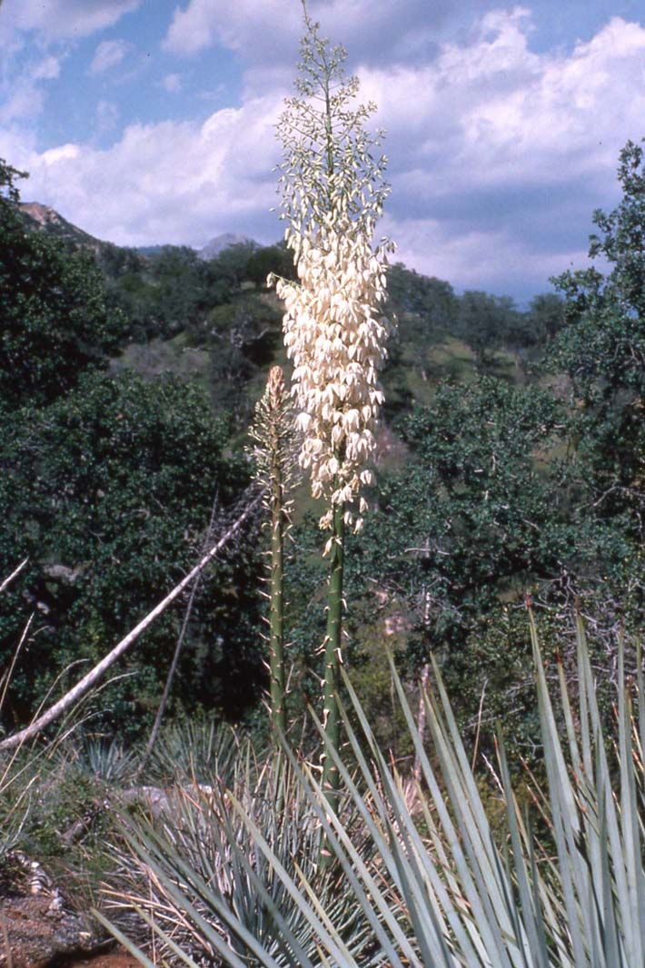
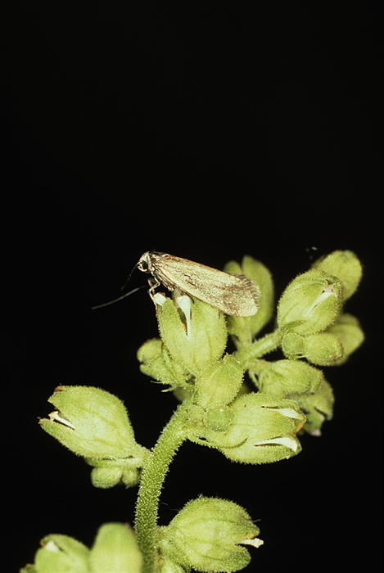
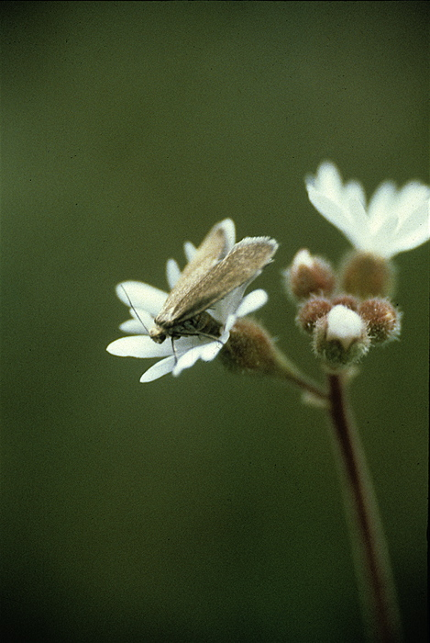
One of the Classic Examples of Coevolution
Prodoxid Moths and Their Host Plants
Yucca
moths
Greya moths
G. variabilis
Some unknown
ancestor
G. subalba
G. enchrysa
G. obscura
G. mitellae
G. politella
G. piperella
Moderately
Efficient
Mutualist
Highly
Efficient
Mutualist,
Sometimes
Exclusive
Antagonist
Commensal/
Antagonist
Inefficient
Mutualist
Obligate
mutualist
(What we knew in 1979)
Thompson, Pellmyr, Segraves, Althoff, Brown,…

Slide 2
What We Now Know:
Diversification of Traits and Ecological Outcomes
Prodoxid Moths and Their Host Plants
Yucca
moths
Greya moths
G. variabilis
G. subalba
G. enchrysa
G. obscura
G. mitellae
G. politella
T. maculata
G. piperella
Antagonist
Commensal/
Antagonist
Inefficient
Mutualist
Moderately
Efficient
Mutualist
Highly
Efficient
Mutualist,
Sometimes
Exclusive
Obligate
mutualist
Thompson, Pellmyr, Harrison, Brown, Segraves, Althoff, Cunningham, Nuismer, Merg, Cuautle, Rich, Laine, Schwind, Friberg, Raguso,…

Slide 3
Diversification of Derived Taxa in Drier Habitats
Basal Prodoxidae
Basal Greya
Derived Greya
Yucca moths
Wahlberg et al. 2013 for Prodoxidae
Pellmyr et al. (various) for Yucca moths
Thompson et al. and Pellmyr et al (various) for Greya

Slide 4
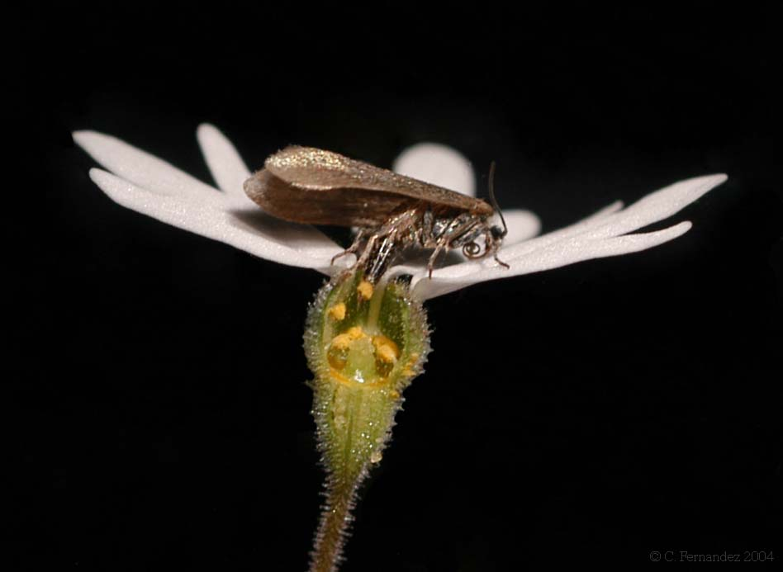
Pollination Mutualisms Evolved More than Once In Prodoxid Moths
Pollinators
18
Monocot-feeders
5
Eudicot-feeders
+
5-6
Thompson 2014 in Grant and Grant, eds., In Search of the Causes of Evolution, Princeton Univ. Press

Slide 5
These Mutualisms Involve Two Plant Families
Agavaceae
Agavaceae
Saxifragaceae
Thompson 2014 in Grant and Grant, eds., In Search of the Causes of Evolution, Princeton Univ. Press

Slide 6
The Moths Ensure Developing Seeds for Their Offspring: Actively in Yucca Moths
Apiaceae
Agavaceae

Slide 7
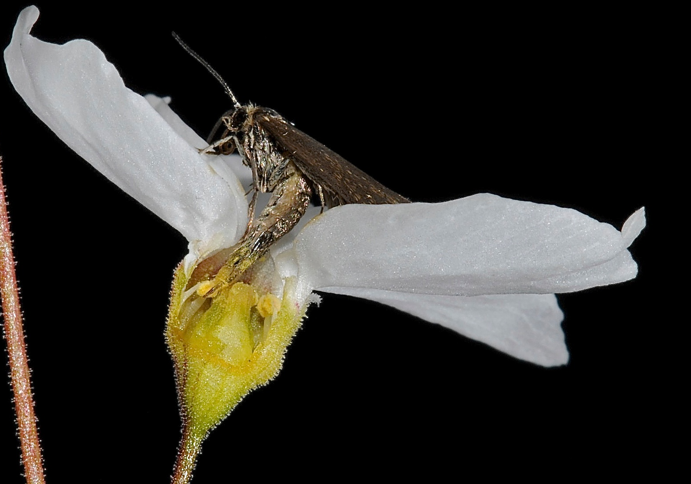
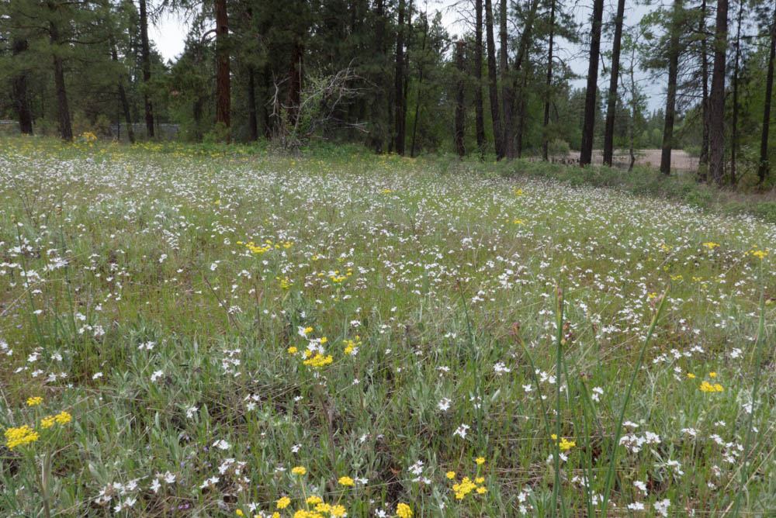
Passively in Greya moths:
Greya politella on Woodland Stars (Lithophragma)
Photos: John N Thompson

Slide 8
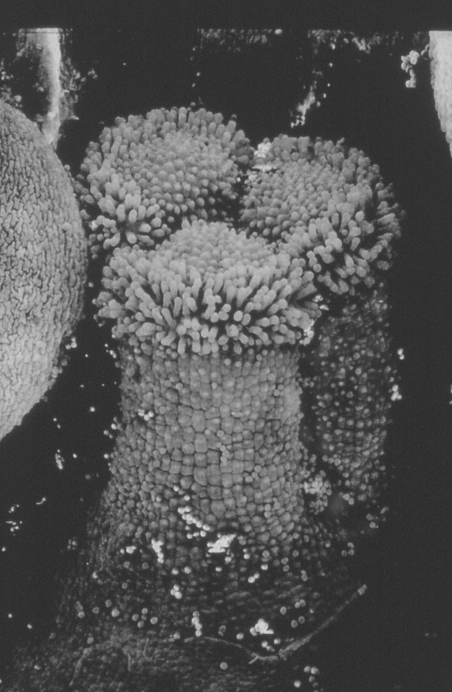
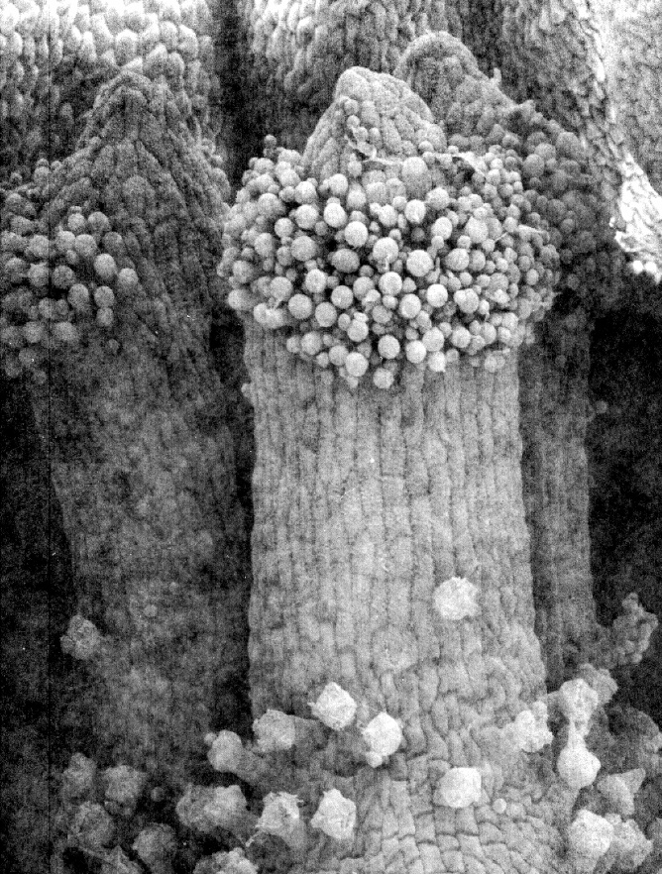
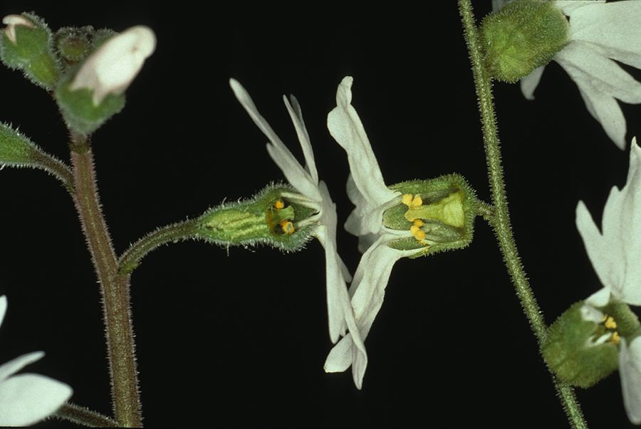
Variable stigma & style height, shape, etc.
Lithophragma
(Woodland star)
Traits Coevolved
With Greya Moths
Unique traits in
Lithophragma parviflorum
and
Greya politella
Variable
floral width
ovary depth
petal “platform”

Slide 9
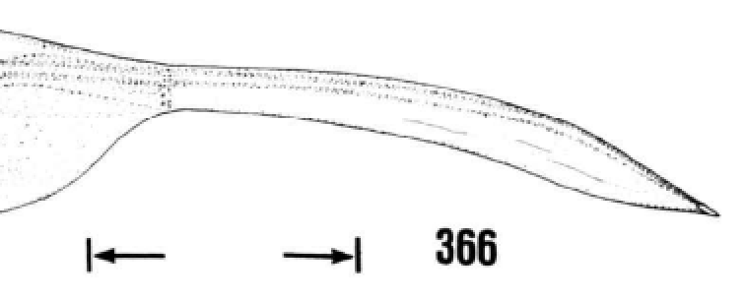
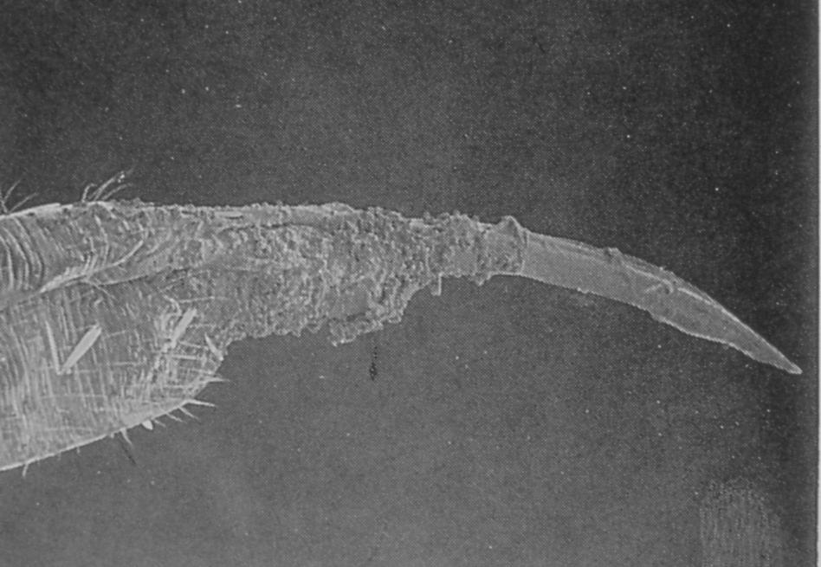
Greya: Variable coevolved traits
Ovipositor
Elongated
terminal segment
Elongated
membrane
Elongated membrane
Pollen

Slide 10
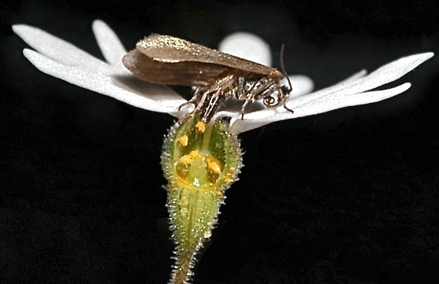
Allopatric Diversification:
G. politella cryptic taxa
On Lithophragma species
Washington
Oregon
3.3%
(COI difference)
California
3.1%
Rich et al. 2008 Mol. Ecol.; Thompson et al. 2013 PNAS, 2017 Am. Nat.

Slide 11
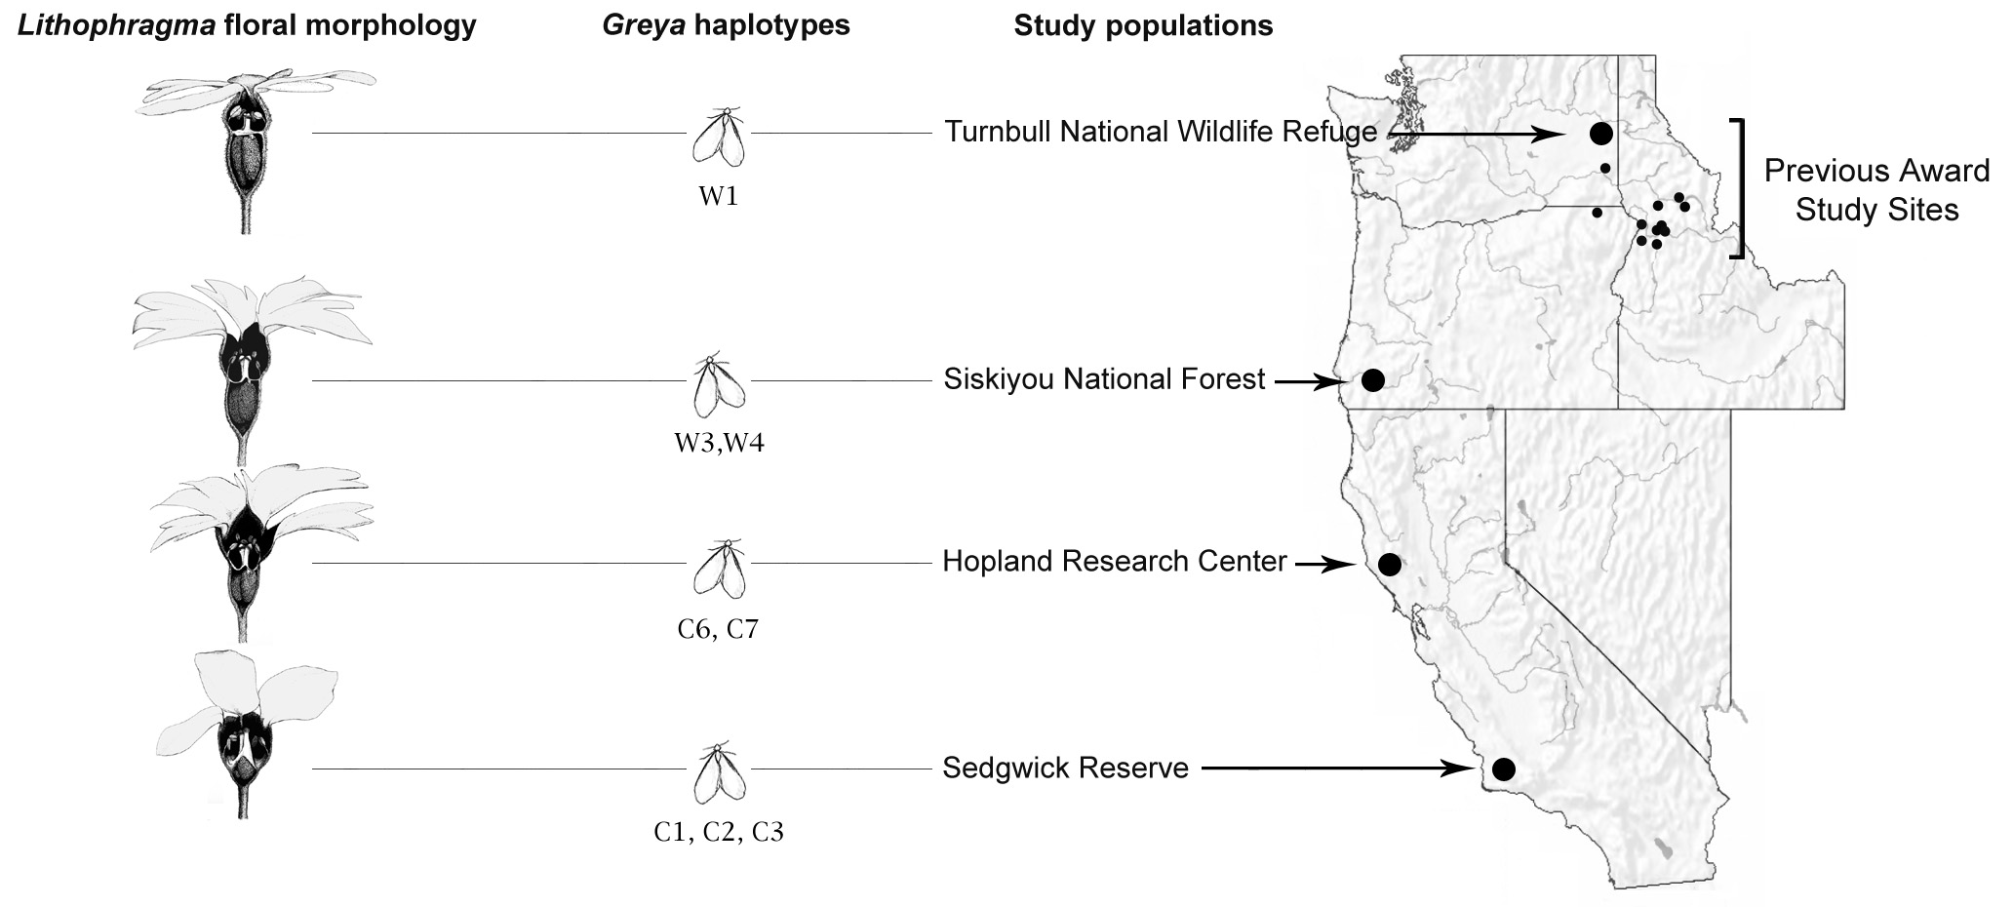
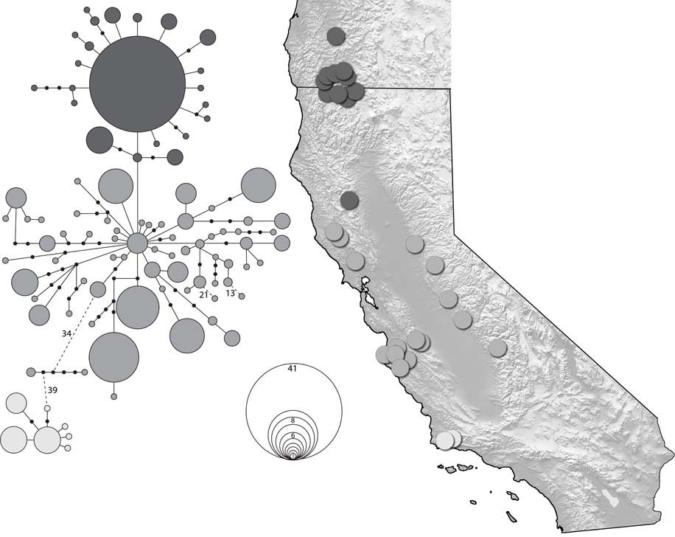
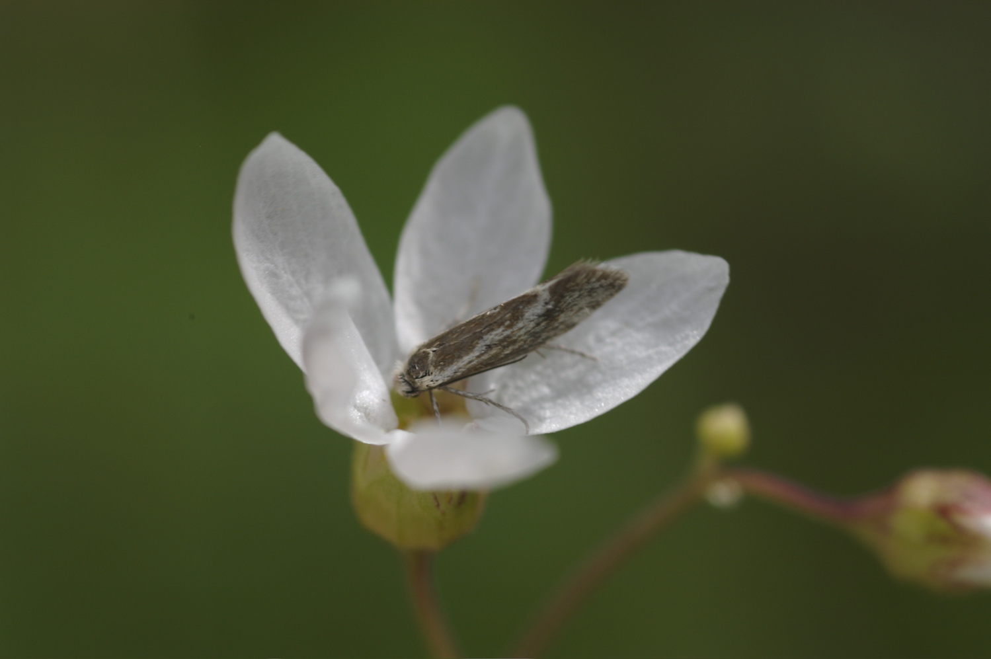
Greya and Lithophragma geographic covariance
Greya obscura complex is embedded within G. politella range and also pollinates Lithophragma
Washington
Oregon
Idaho
California
G. obscura complex
G. politella complex
The ifficient pollinator
Thompson and Rich 2011 J. Biogeo.; Thompson et al. 2010 Ecol. Lett.

Slide 12
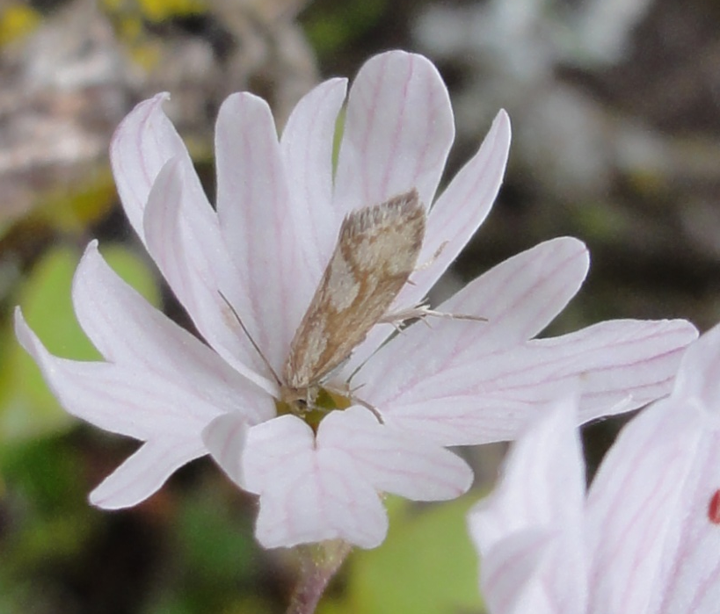
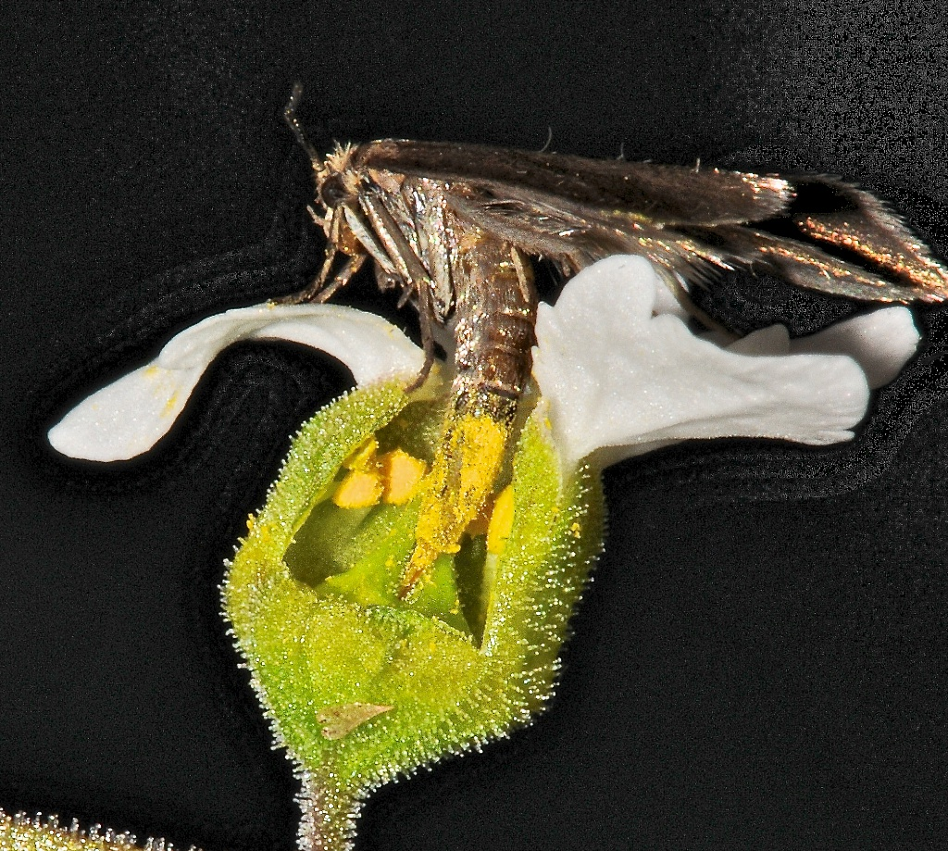
Coevolution Varies Geographically: Pollination by One vs. Two Moth Species
Pollination with Head in Greya obscura
(Lays eggs in base of ovary or stem,
not through corolla)
Pollination mostly with abdomen
During egg-laying through corolla in G. politella
Photos: John N Thompson

Slide 13
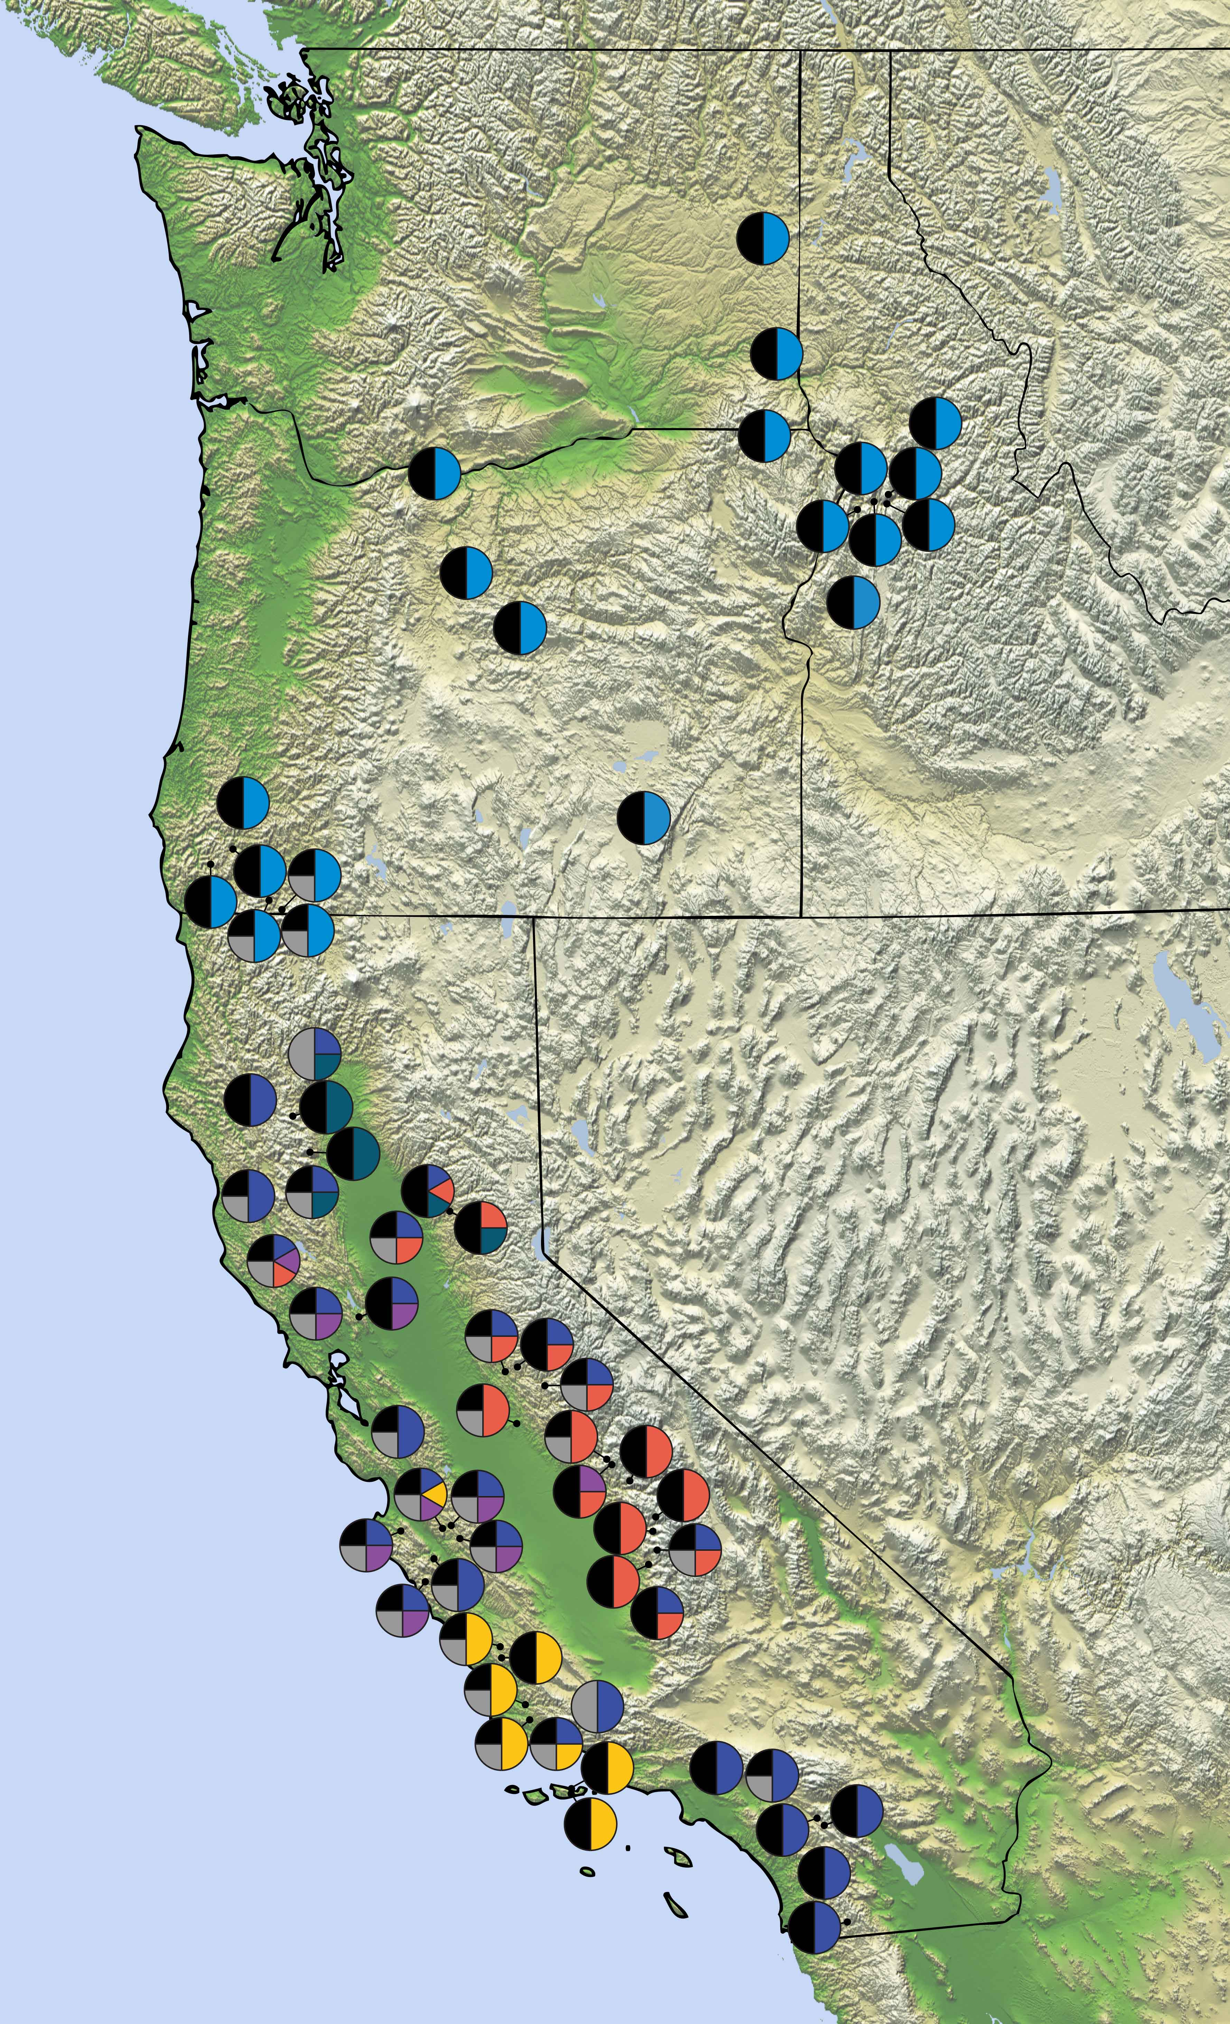
90 Study Sites across 1900 km (i.e., local coevolutionary experiments) A subset of the sites is shown here. Assess: Which species interact locally Plant and moth traits Ecological outcomes (subset) Analyze: Divergence among populations Divergence among species
Washington
Oregon
Idaho
California
Thompson et al. 2017 Am. Nat.

Slide 14
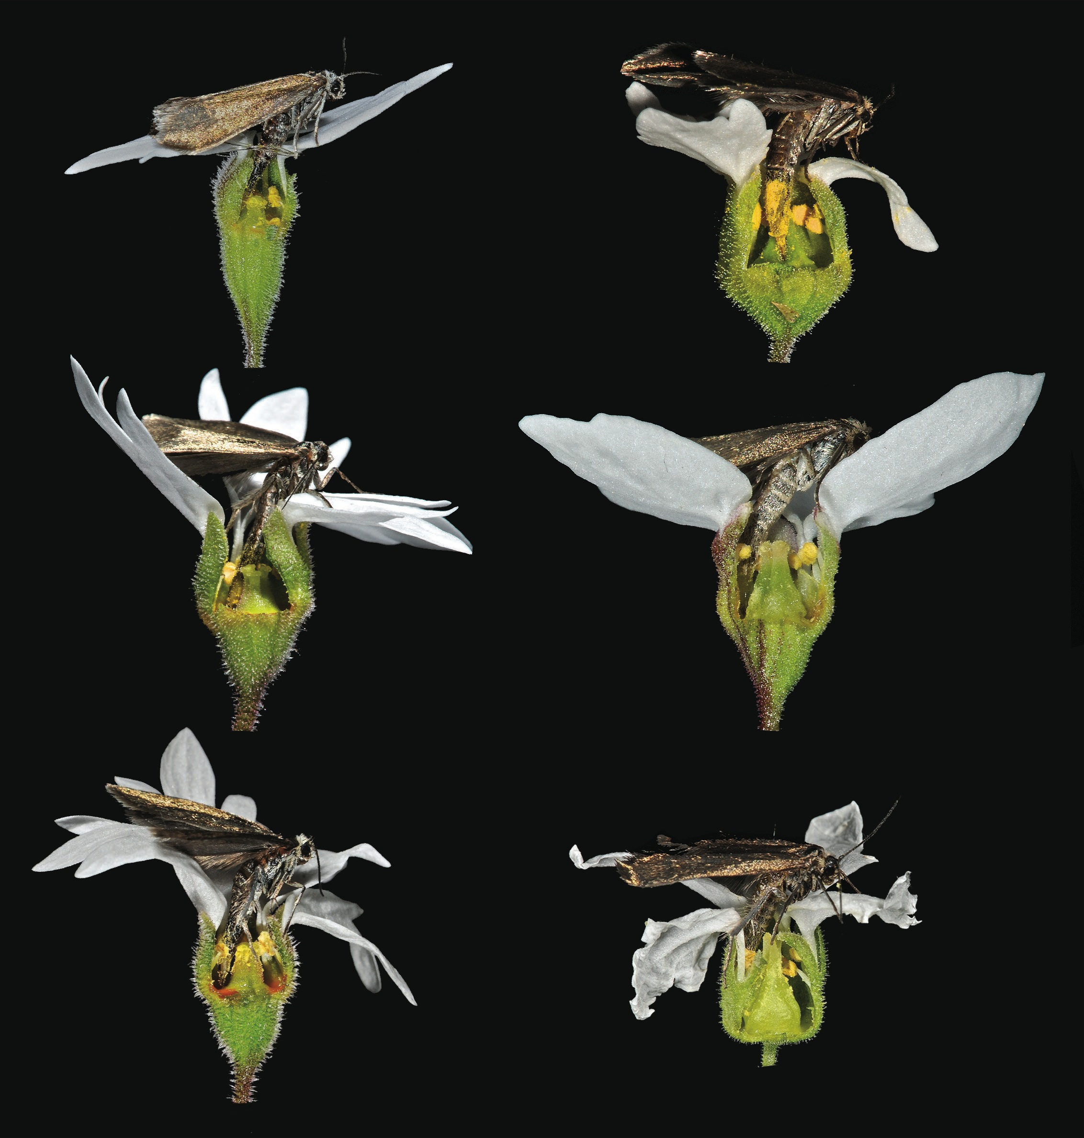
Lithophragma Floral Shapes and Position of Pollen on Greya politella Moths Differ Among Species and Geographically within Species
Lithophragma
2, 4 = Greya hosts
Thompson, Schwind, Guimarães, and Friberg 2013 PNAS

Slide 15
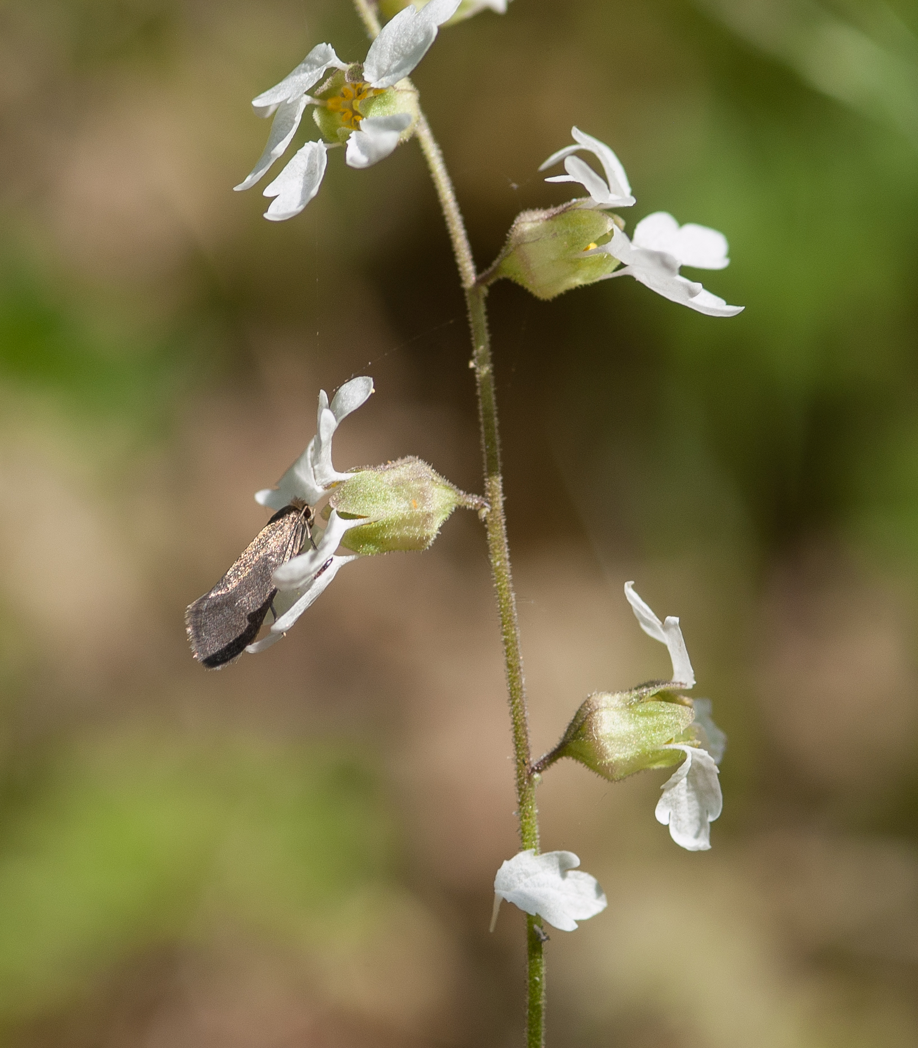
Geographic Mosaic of Coevolving Network of Lithophragma bolanderi and G. politella vs. G. obscura
Washington
Oregon
Idaho

Slide 16
Example 1: Lithophragma affine
Washington
Oregon
Idaho
California

Slide 17
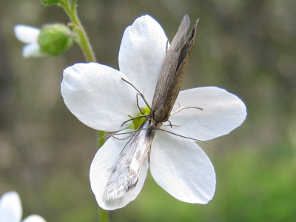
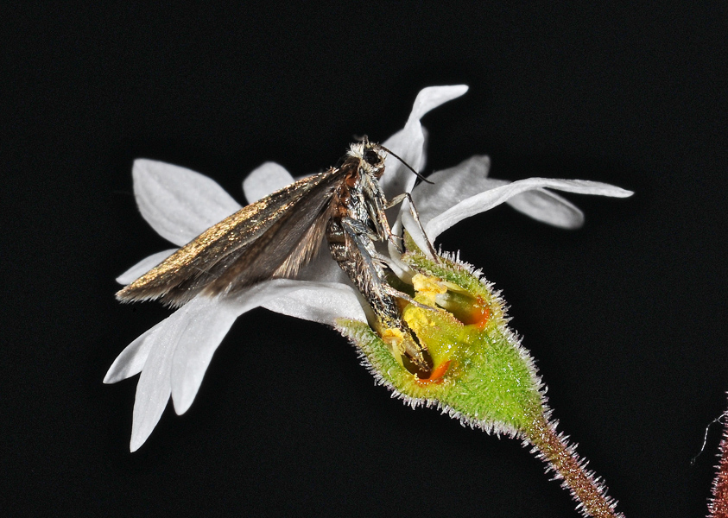
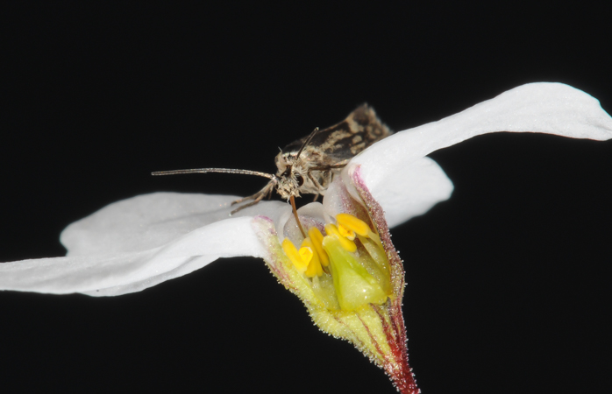
Divergence Among Populations AND Species in Correlated Traits
Blue = pollinated by G. politella Red = pollinated by G. obscura Black = both pollinators Grey = Neither Greya present
Canonical Axis 2
more floral flair
larger stigma
taller style
- larger petals
- wider flower
shallower ovary
-2 -1 0 1 2
-2 -1 0 1 2
Canonical Axis 1
Canonical Axis 1
Thompson et al. 2017 Am. Nat.

Slide 18
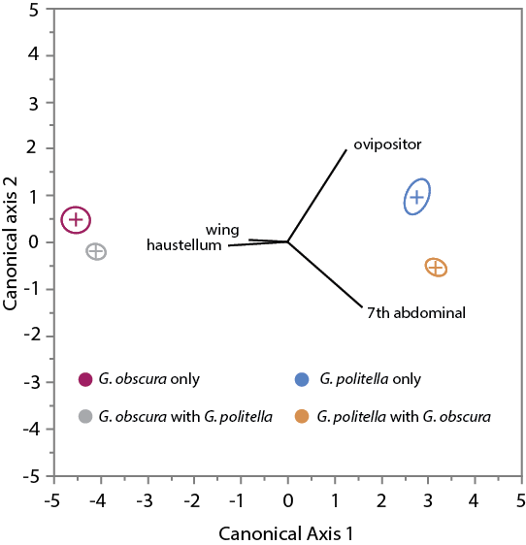
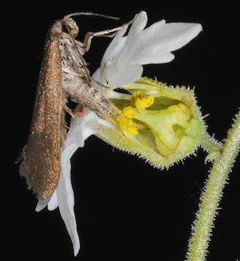
Moth Traits also Vary: Sympatry vs. Allopatry
Thompson et al. 2017 Am. Nat.

Slide 19
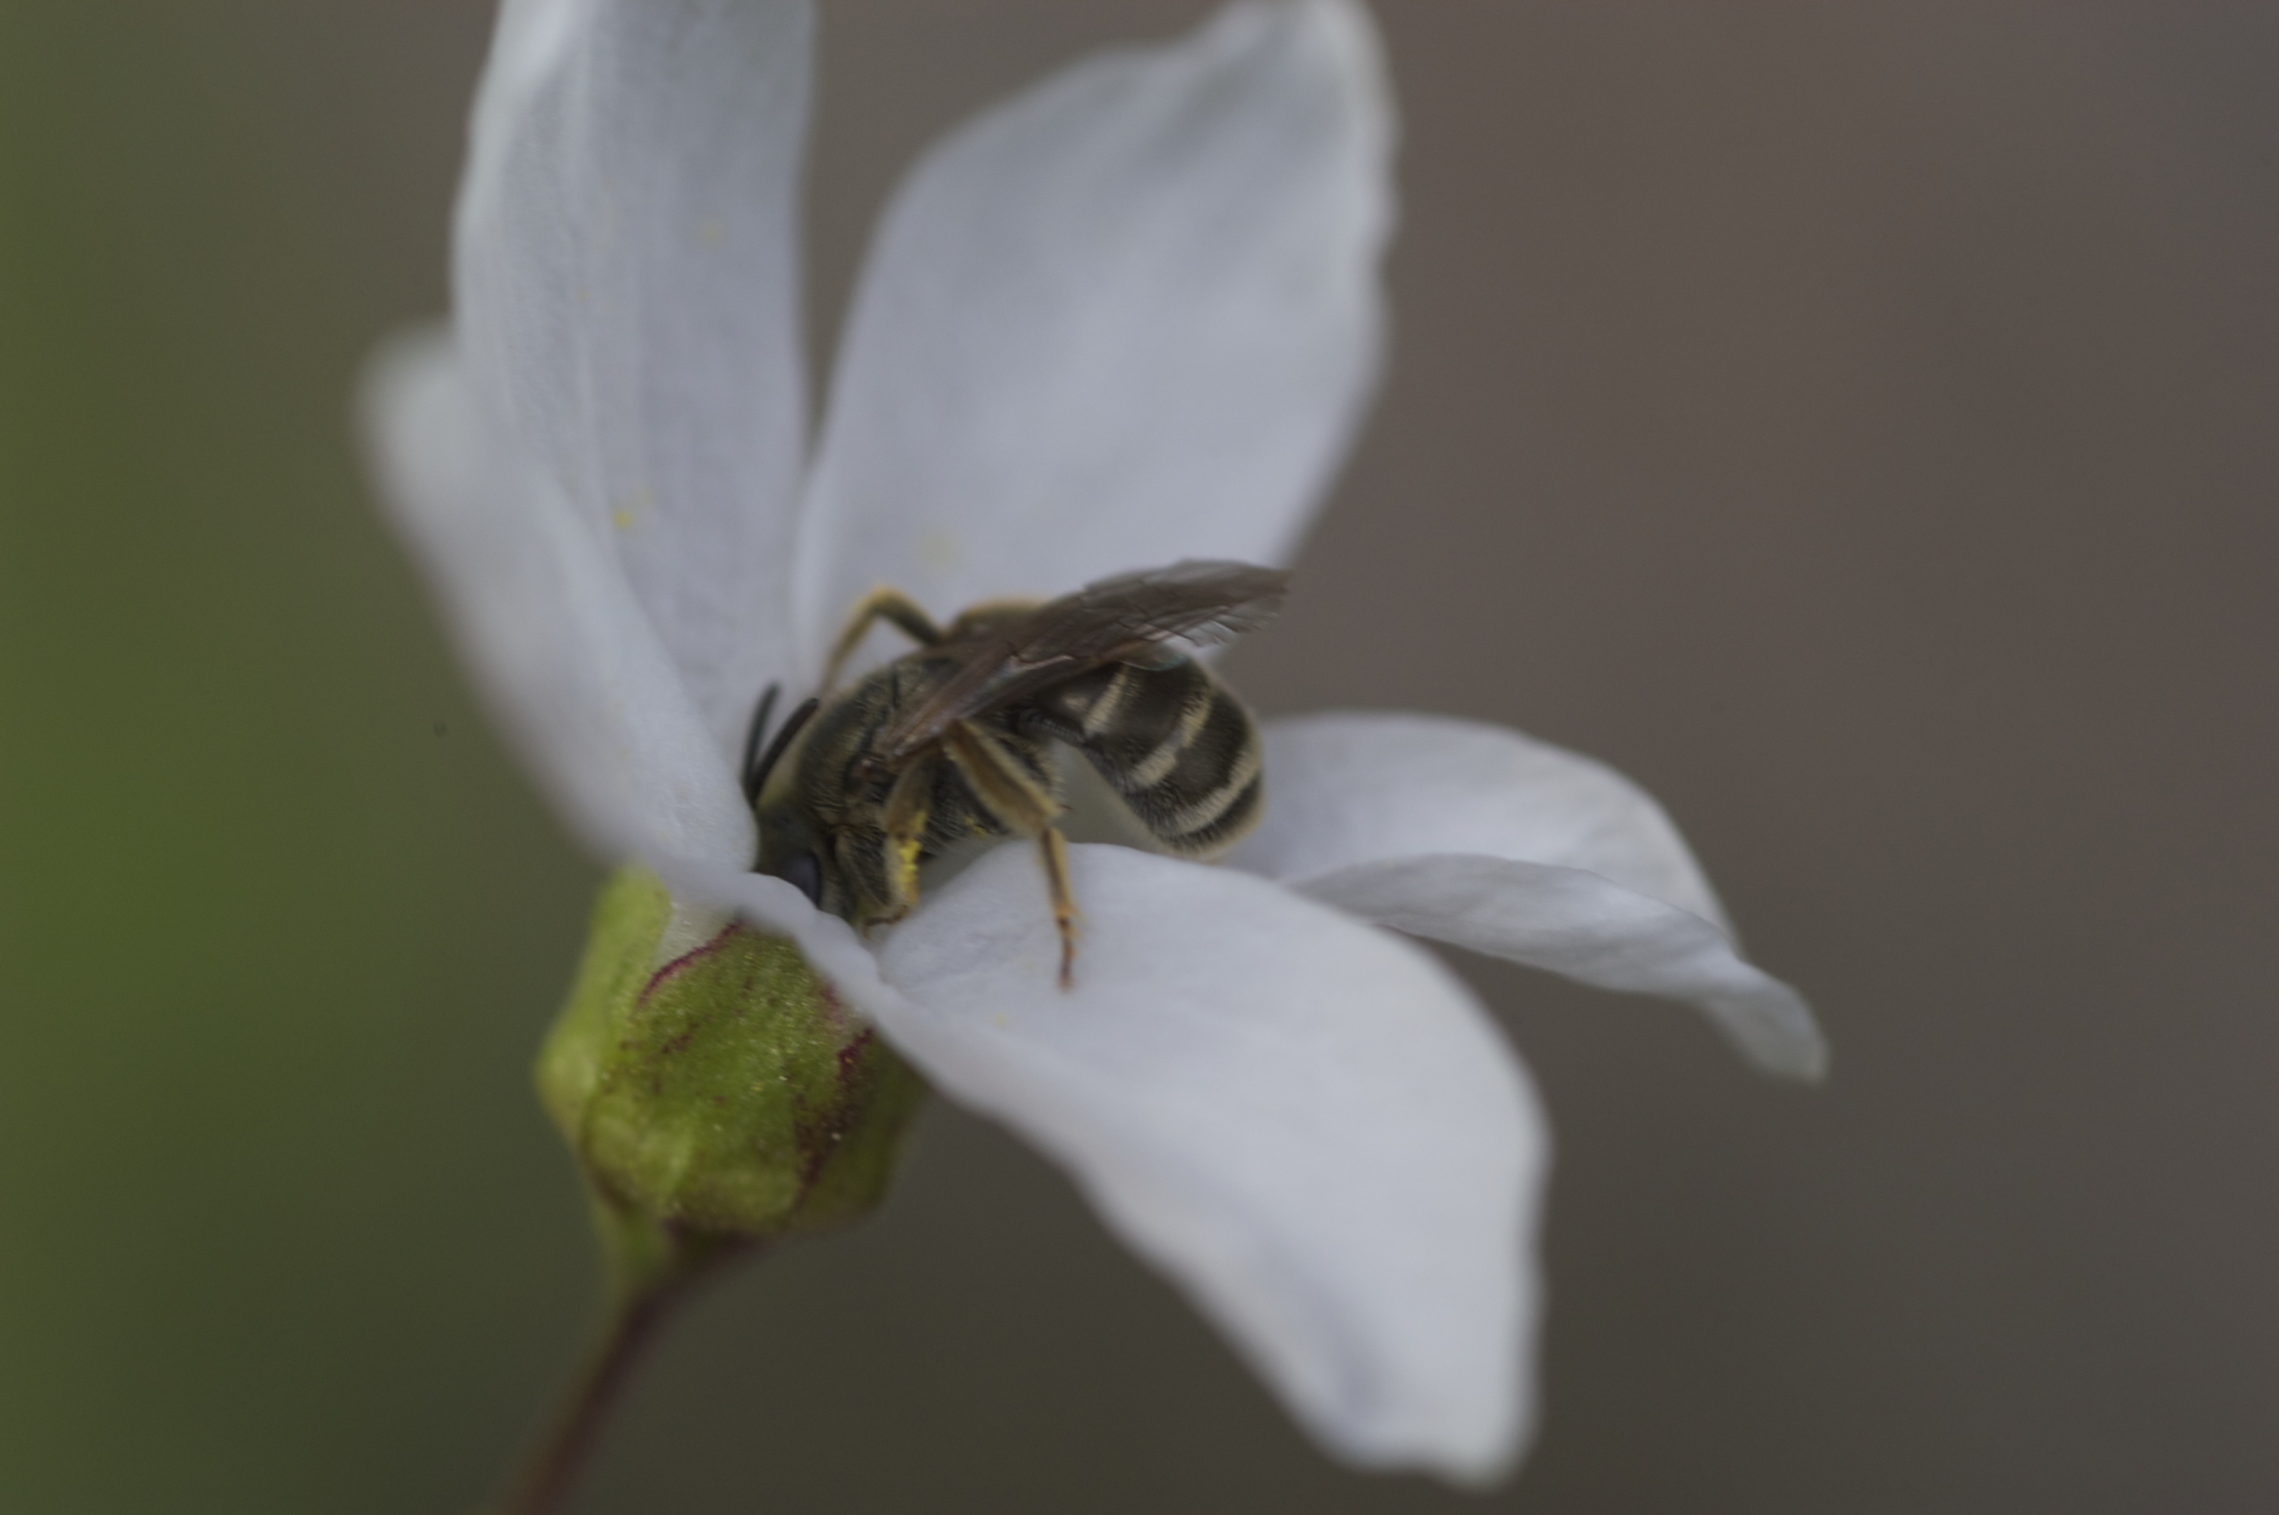
Other Tiles in this Geographic Mosaic of Coevolving Species:
Mutualism is Coopted by Other Taxa in Some Populations
Near the Northern Edge of the Range of Lithophragma
Source: John N Thompson
Notes:
Upper left: A Greya politella moth ovipositing in one flower, while a bee-fly nectars at another flower. In some ecosystems bee-flies and solitary bees can swamp the mutualism
Between the moths and the plants
Lower left: A Lithophragma parviflorum plant showing developing capsules at the bottom and a flower at the top. The plants flower along a stem from bottom to top.
Middle: One of the sampling designs used to assess the ecological outcome of the interaction. Are plants more likely to abort flowers with eggs than
Without eggs? (Another design includes the number of seeds produced by flowers with eggs as compared with those without eggs.) By comparing flowers
With and without eggs on the same plant, we can hold the effects of plant genotype constant. We assess many plants in each population.
Right: A cartoon showing a developing capsule and an aborted capsule. We collect the developing and aborting capsules on each plant before the aborted
Capsules have fallen off.

Slide 20
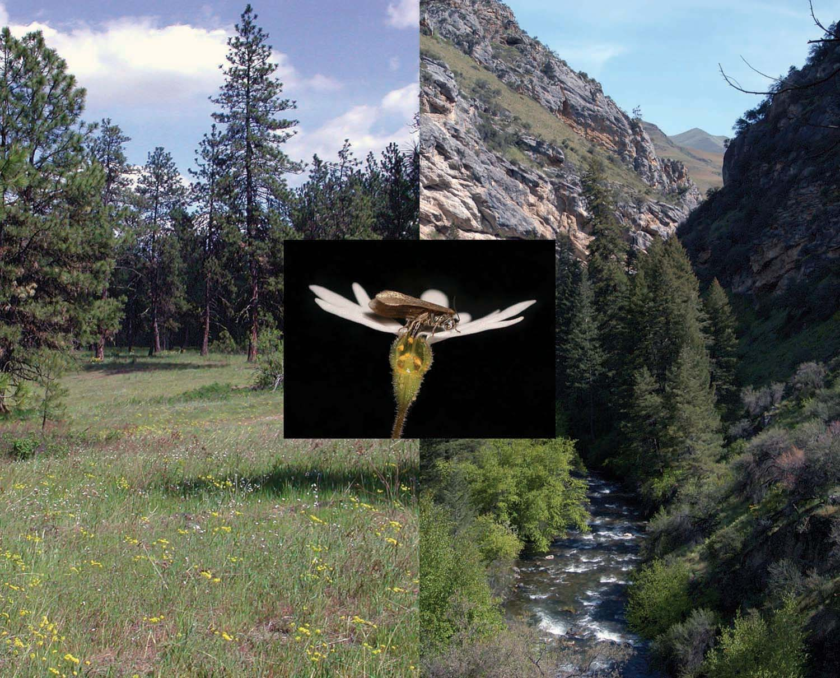
Ecological Outcomes of Lithophragma/Greya Interactions
Near Northern Range Limit
= Mutualistic
= Antagonistic
= Commensalistic
Washington
Oregon
S
e
l
w
a
y
R
.
Idaho
S
a
l
m
o
n
R
.
I
D
A
California
H
O
0
Km.
100
S
n
a
k
e
R
.
Thompson and Cunningham 2002 Nature
Thompson and Fernandez 2006 Ecology
a
a
a
a
a
a
a
Notes:
1

Slide 21
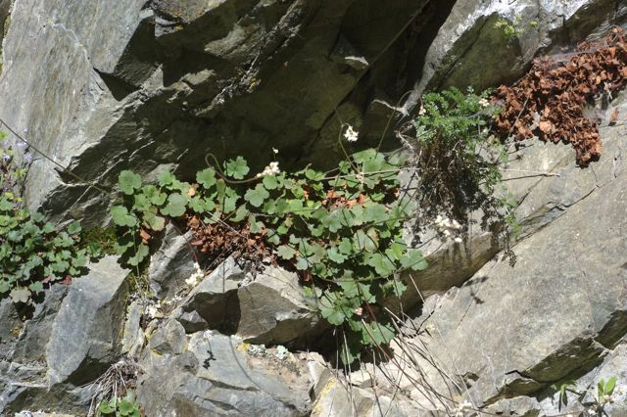
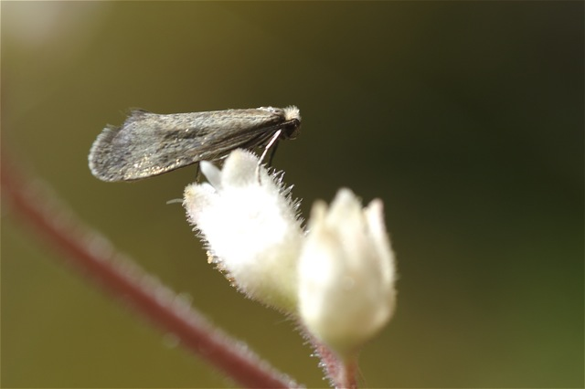
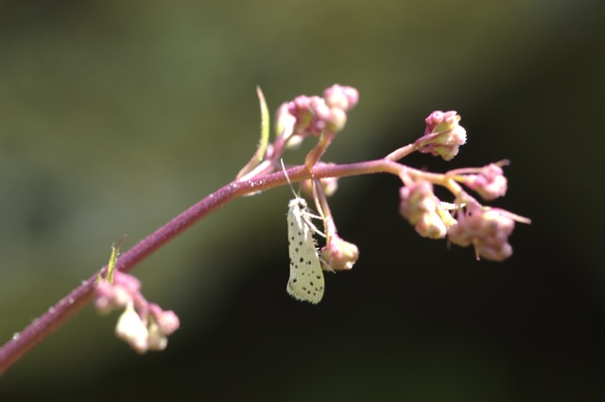
Shift of Greya Species onto Closely Related Genus Heuchera In Rocky Mountains Depends on Plant Ploidy
on 4N plants
on 2N plants
G. politella 2
G. piperella
Thompson et al. 1997 Am. Nat., Nuismer and Thompson various; Thompson and Merg 2010 Ecology

Slide 22
Pattern of Greya Use of Lithophragma and Heuchera in Rocky Mountains
Lithophragma
4N Heuchera
2N Heuchera
G. politella 1
G. politella 2
G. piperella
“1” and ”2” = possible cryptic species
G. piperella is closely related to G. obscura
Thompson et al. 1997 Am. Nat., Nuismer and Thompson various; Thompson and Merg 2010 Ecology

